Slide 1
TYPO3 MASTER
PowerPoint Master for TYPO3 Presentations
John Doe
john.doe@typo3.org
@typo3

Slide 2
Agenda
Point 1
Point 2
Point 3
Point 4
Point 5
Point 6
Point 7
Point 8
Point 9
Point 10
Point 11
Point 12
Point 13
Point 14

Slide 3
What is TYPO3?

Slide 4
TYPO3 CMS

Slide 5
TYPO3 CMS
Open source software
= access to source code
Content Management System
= the interplay of code and content
Developed and maintained by a community of developers from around the world
Backed by a commercial entity, TYPO3 GmbH

Slide 6
TYPO3 CMS
An estimated 500,000 installations, e.g. websites, intranets, mobile
Provides a solid and powerful foundation for creating any internet project whatsoever
Can be customized to perfectly fit individual needs
Well-established
Wide range of choice when it comes to finding a TYPO3 agency or freelancer to work together with

Slide 7
Driven by passion and enthusiasm
Estimated amount of time invested into TYPO3 CMS: 1127 years
Contributors per month: more than 30*
Supported by approximately 800 TYPO3 Association members
  (source: https://www.openhub.net/p/typo3)

Slide 8
TYPO3 CMS - facts & figures
More than 1,500 compatible extensions
Almost 10,000 TYPO3 features
More than 9 million downloads

Slide 9
Current major versions
Every Long Term Support (LTS) version is supported for 3 years with security and bug fix releases
A new, stable, major version of TYPO3 CMS is released every 18 months

Slide 10
Current major versions
This means that there are always 2 stable versions being maintained
As of mid-2017 that’s versions 7.6 and 8.7
TYPO3 CMS version 6.2 became officially unsupported by the community in March 2017 (when TYPO3 CMS 8.7 LTS was released)

Slide 11
Features

Slide 12
Free and independent
100% Open Source Software
Access to the source code
You can get the system customized to your wishes
No license fees
Implementation, customization and maintenance will need to be done by professionals

Slide 13
Free and independent
Self-hosted or hosted in the cloud
  The choice of server is all yours
  TYPO3 CMS can be installed on any server that supports the system requirements
  TYPO3 CMS has no binding to a specific hosting partner

Slide 14
Reliable and scalable
Reliable and state-of-the-art web technology
  HTML5, CSS, SASS, LESS, Twitter Bootstrap or Zurb Foundation: TYPO3 CMS plays well with each and every one of them
  You can choose what you like for rendering your website or online application - for mobile-friendly and mobile-ready solutions

Slide 15
Reliable and scalable
Scalable according to business needs
  Allows adaption to specific requirements
  TYPO3 CMS is targeted towards further growth
  The technologies we use are designed for maximum performance (e.g. built-in caching, high-speed lean API access)

Slide 16
International and secure
Go global
TYPO3 CMS has 15+ years of experience with multi-language sites

Slide 17
International and secure
Go global
TYPO3 CMS has the structure it takes to
  develop complex websites
  with a wide range of content
  in various languages
  whilst remaining user-friendly

Slide 18
International and secure
Safety first
  Security team We have a dedicated team of experienced developers who take care that the software keeps safe
  Common Vulnerability Scoring System (CVSS) Additionally, the team uses CVSS to track and evaluate potential threats

Slide 19
Extendable and mobile
Extendable functionality
  API You’re able to adapt a growing system to meet your needs
  Extension Repository Wide range of extensions for just about any feature you can think of (free of charge). If what you’re looking for isn’t in the repository, you can have it

Slide 20
Extendable and mobile
Mobile friendly out of the box
  Frontend: TYPO3 CMS comes with what it takes to build state-of-the-art and adaptive websites
  Backend: TYPO3’s backend scales properly to devices, meaning that content can be edited on any device whatsoever, be it desktop, tablet or smartphone

Slide 21
Gain valuable time
TYPO3 enables you to work fast
preparing content
  e.g. integrated image editing
  TYPO3 CMS sets standards in image editing. Scaling and cropping images is simple. It’s also possible to compose new images for your project within TYPO3 CMS

Slide 22
Gain valuable time
Delivering your site anywhere around the world
  e.g. built-in CDN support TYPO3 CMS makes distributing assets across the globe really easy. No training is needed in order to use Content Delivery Networks (CDN) such as Akamai or CloudFront.

Slide 23
Multisites & Corporate Identity (CI)
Multisite: one backend & many sites
  With one single program installation of TYPO3 CMS you can
    Handle everything!
    The number of sites, your features, your layouts, user roles, and so on

Slide 24
Multisites & Corporate Identity (CI)
Implementing CI into a web project is easy
  Adjust the visual appeal of the admin interface by uploading your logo and setting your main CI colors
  Add a finishing touch with a background image of your choice

Slide 25
Export/import
migrating from A > B = easy!
  built-in export/import for sites, meaning
  export your site on one server
  then simply import it on another one
  or even create pre-defined sites off your own template by importing the same site a number of times into the same TYPO3 installation

Slide 26
Access permissions and schedulable
Simple and granular access permissions
  TYPO3 CMS allows you to allocate specific rights
  set up the user authorization system exactly how you want it to be

Slide 27
Access permissions and schedulable
Simple and granular access permissions
Entire website
  specific pages
  subdomains
  a single extension
  or even one specific content element!
A nice side effect: the backend gets less complex for those using it, which makes their work more efficient

Slide 28
Media integration: handling local and remote media
Simple way of handling remote files like videos (YouTube, Vimeo, etc.)
Use the same methods to access both local and remote files

Slide 29
Assuring standards and quality
High-quality code through QA guidelines
  Before new code is merged into TYPO3’s core, it undergoes a thorough check to ensure that everything performs as intended
  Specific tests are used to detect flaws and bugs
  New code only gets integrated into the TYPO3 core if the whole review process is successfully completed
  Over 8,000 automated tests, including unit tests, functional tests, acceptance tests, and integrity test

Slide 30
Workflows & full control
TYPO3’s workspaces allow you to
publish content based on a defined workflow
keep track of changes and workflows
have different versions of data
create and delegate to dos

Slide 31
Workflows & full control
Full control over your site’s design and SEO
Unlimited customizability
The source code can be accessed, changed and modified in any way you like
Websites can be created that perfectly meet customers’ needs
Wide range of “onboard” options for optimizing content for search engines (SEO)

Slide 32
Sustainable & multi channel
Planning made easy
Long Term Support (LTS) for major releases
Every LTS version is supported for 3 years via standard support
During this period of time, security fixes and bug fixes are free of charge
A new major version is released every 1 ½ years
So there are always 2 stable versions being maintained

Slide 33
Sustainable & multi channel
Multi-channel content publishing
  Publish content in different formats like XML, JSON, PDF or just the usual HTML
  This makes it easy to create print versions or RSS feeds from the content you have

Slide 34
Databases ... we love them :-)
Free choice of database
  TYPO3 runs best with MySQL, but you can also use any other database management system (DBMS) like Oracle, Microsoft SQL Server or PostgreSQL

Slide 35
Quality and development of TYPO3 CMS

Slide 36
Planning made easy: a clearly defined roadmap
3 years support for every LTS version
Update and support cycles clearly defined
Releases and updates are scheduled long in advance

Slide 37
Regular updates
Updates and upgrades are made throughout the year
Approximately once every 2 weeks
Release notes are published on typo3.org

Slide 38
Current version: 8.7 LTS was released in April 2017

Slide 39
Goals achieved
Cloud integration
backend is responsive work wherever you are, with a smartphone, a tablet, or a good ol’ desktop computer
image adaption for responsive websites with a single click
Rich Text Editor has been modernized an eye catcher and easy to handle

Slide 40
Transparency and safe planning for the future
release dates of every LTS version are determined well ahead of time
intermediate steps (so-called “sprint releases”) are well documented
everything is published on typo3.org
= transparency!

Slide 41
Current LTS versions at a glance
8.7 LTS full support until April 2020
7.6 LTS full support until December 2018

Slide 42
Current LTS versions at a glance
6.2 LTS marked unsupported in April 2017
  ELTS: If you’re still using this version, you may want to consider purchasing an Extended Software Support Agreement
  TYPO3 GmbH’s offer gives you an extra 12 months of security bug fixing

Slide 43
Community driven approach
Experienced and skilled developers from all around the world are constantly maintaining and developing this open source software
Innovative ideas and solutions
Rock solid technical foundation
High level of marketability

Slide 44
QA (Quality Assurance): Sprint Releases
Sprint Releases
  Before a new TYPO3 LTS version is released, several so-called sprint releases are published
  These are intermediate releases and give a glimpse into the progress of development
  Pave the way to a stable and well functioning software
  Create a constantly evolving solution

Slide 45
QA (Quality Assurance): Sprint Releases
Minor versions are numbered serially
  with decimal digits in the format: <major>.<minor>
  e.g. 7.6.5 or 8.7.2

Slide 46
Sprint Releases: getting priorities straight
Transparency
progress (and obstacles encountered on the way!) towards a new LTS version is published regularly and for all to see

Slide 47
Sprint Releases: getting priorities straight
Verification
The current state of the development can be assessed and anything that needs fixing (bug fixing), can be done prior to the final release

Slide 48
Sprint Releases: getting priorities straight
Adjustment
By breaking tasks down, the complex job of developing a new LTS is structured
Any fine tuning needed can be done prior to releasing a LTS version

Slide 49
TYPO3 CMS IS

Slide 50
TYPO3 CMS is
A powerful content management system
Flexible
Has the structure it takes to develop complex websites which are nevertheless user-friendly
Attractive, especially for large enterprises

Slide 51
TYPO3 CMS could be the right software for you, if ...

Slide 52
TYPO3 CMS could be the right software for you, if ...
You need to create and handle digital content of any kind
You know that business will be growing - your business may evolve, but you'll never need to change the software, as TYPO3 CMS can easily be adapted to growing needs

Slide 53
TYPO3 CMS could be the right software for you, if ...
  Examples:
    Websites, intra- and extranet
    Apps
    Content, etc. and beyond

Slide 54
Handle any kind of content
Create a website, app, or a complex system
  no matter if the amount of content you have to deal with is large or small
Pictures
Documents
Videos
Databases, etc.

Slide 55
Business benefits
updating and maintaining content is easy - be it music, videos, games, or articles
creating multilingual websites is easy
supports global distribution of content via GEO-IP to automatically transfer visitors to the proper country
device sensitive features also support mobile versions of your content

Slide 56
TYPO3
Case Studies

Slide 57
Who uses TYPO3?

Slide 58
References

Slide 59
User types
Startups
Small and medium-sized enterprises (SME)
Large enterprises and organizations
Start small → grow as you need!

Slide 60
Who’s WHO

Slide 61
TYPO3 Association

Slide 62
TYPO3 Association
Not-for-profit organization
Established in 2004 to provide funds for long-term goals
Registration in Baar ZG, Switzerland

Slide 63
TYPO3 Association
Approximately 800 members from around the world
Receives most of its funding through membership fees, donations, and the annual TYPO3 Conference (T3CON)
Anyone can apply for funding for projects, as long as the project provides substantial and sustained value to its users

Slide 64
Strategic goals of the TYPO3 Association
Increase the number of people involved
Uphold values and good spirit
Increase market share / usage of TYPO3 CMS
Increase confidence in products
Provide CMS industry insights

Slide 65
TYPO3 bodies
General Assembly (GA)
  The GA elects the board, controls its work, and generally decides on all matters of importance in its annual meeting. It is open to all members.

Slide 66
TYPO3 bodies
Board
  The board is the executive body that takes care of daily administrative work, legal matters, and accounting.
Expert Advisory Board
  The expert advisory board is responsible for managing the affairs of the association.

Slide 67
TYPO3 bodies
Business Control Committee
  The business control committee can review all project loans for conformity of expenditure with the loan application, achieving the set objectives and cost-effective completion of projects.

Slide 68
TYPO3 bodies
Committees
  The expert advisory board and the association's board can appoint advisory committees or individual persons without discretionary authority for specific tasks.

Slide 69
Become a member, help the project to grow

Slide 70
Membership levels
Membership that fits your interest
  Community membership
  Bronze, Silver, Gold & Platinum
  Academic Bronze, Silver & Gold
  More to come

Slide 71
Benefits of being a member
Membership ensures the ongoing development of TYPO3
Free or discounted tickets for official TYPO3 events
Logo listing on typo3.org
Vote on important decisions at General Assembly or about the money spent on different projects

Slide 72
Association: activities & teams
Besides giving money to empower the community to get things done, you can also play an active role and help TYPO3 by joining a team or participating in one of the many sprints. We need people with all kinds of skills, and also developers, of course.

Slide 73
Association: activities & teams
Teams you can join
Education
Design
Community Marketing
Server
Documentation
Events

Slide 74
TYPO3 GMBH

Slide 75
TYPO3 GmbH
2016, the TYPO3 Association founded an operational arm: TYPO3 GmbH
Service company
Attends to the technological development of TYPO3 CMS
The resolution to found the company was passed unanimously by the General Assembly of the TYPO3 Association
TYPO3 GmbH is independent of investors and venture capital and can therefore focus 100% on the growth of the TYPO3 project

Slide 76
TYPO3 GmbH – profile
Headquarters: Düsseldorf (Germany)
founded: June 2016
Ownership: 100% by the TYPO3 Association

Slide 77
TYPO3 GmbH – services
For agencies:
  2nd level support
  Sales representative
  Rent an engineer
  An option for sharpening developers’ skills: “Send your junior!”
  and more

Slide 78
TYPO3 GmbH – services
For customers:
  SLAs
  Partner Program: find a qualified TYPO3 agency or freelancer
  Audits and Reviews
  and more

Slide 79

SPEACIAL LAYOUT LEFT
PLACE COOL STUFF ON RIGHT

Slide 80
SPEACIAL LAYOUT RIGHT
PLACE COOL STUFF ON LEFT

Slide 81
Impossible Is Not a Fact.
It's an Opinion.

Slide 82
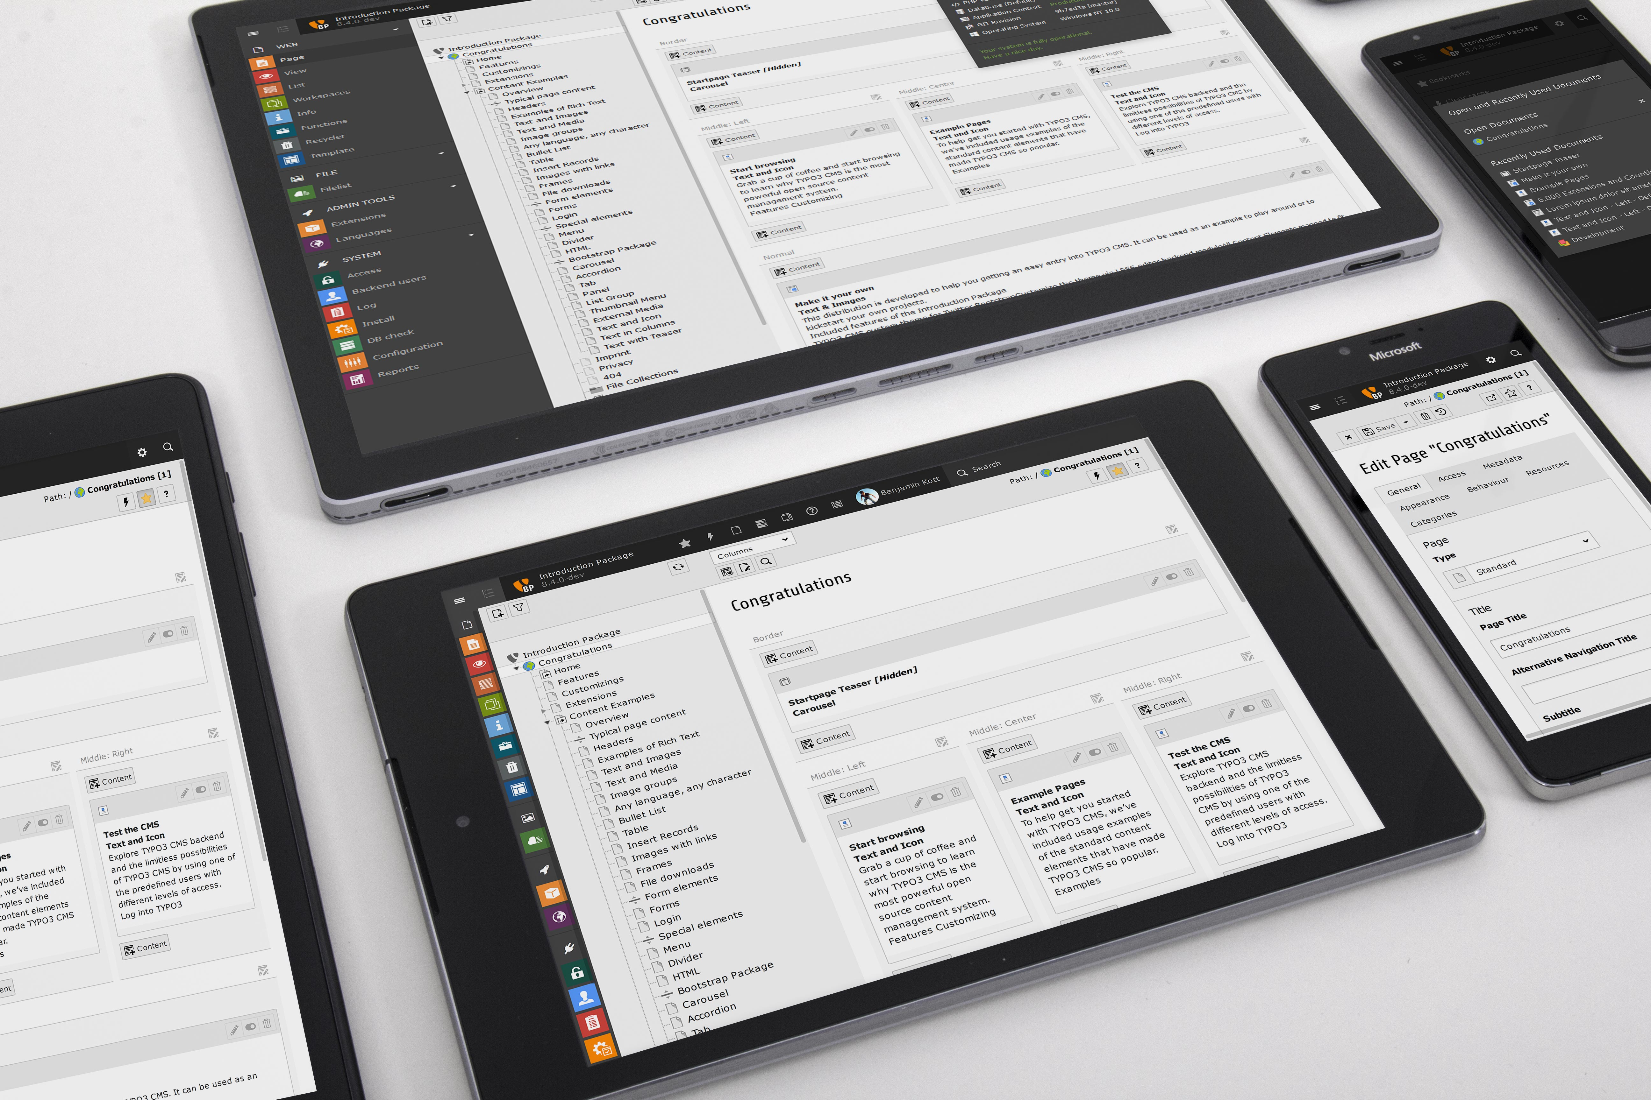

Slide 83
Thank You!

